Slide 1
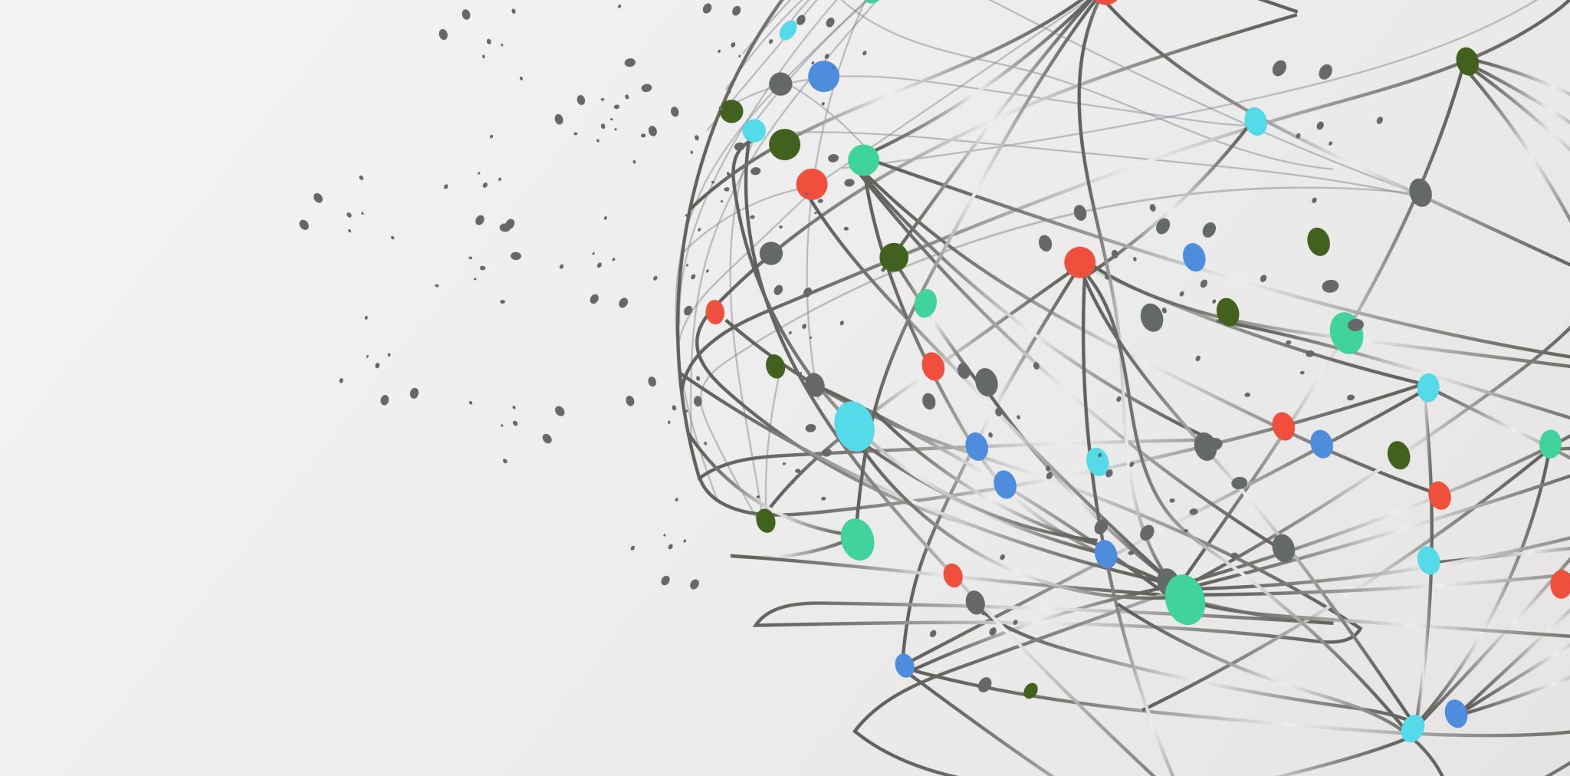

ENPM809K –Breast Cancer Detection Using Denoising Diffusion Probabilistic Model
BY -
MANO SRIJAN BATTULA
SHAMEEK CV
ROHITH SARAVANAN

Slide 2
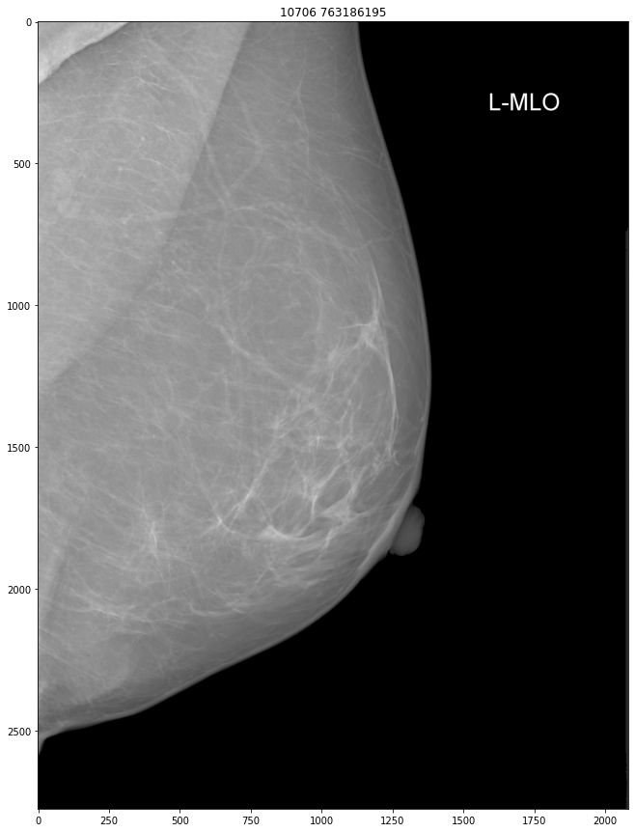

PROBLEM STATEMENT
Breast Cancer Detection: A Critical Challenge:
Problem Overview: The project addresses the challenge of detecting breast cancer, a significant health issue among women globally.
Current Limitations: Traditional neural networks, while vital for cancer screening, faces difficulties in accurately detecting cancerous changes, especially in dense breast tissue.
Motivation for a New Approach:
Need for Innovation: There is a compelling need for more accurate and efficient detection methods with unlabeled data.
Project Motivation: To overcome the limitations of traditional methods and improve early detection, which is crucial for effective treatment.
Notes:
"Breast cancer remains a significant health concern, affecting countless women globally. Traditional mammography, while invaluable, often struggles to detect subtle changes, particularly in dense breast tissues."
"Our project introduces the Denoising Diffusion Probabilistic Model a novel deep learning approach for breast cancer detection. Unlike conventional approaches, DDPM identifies these subtle anomalies in breast tissue, offering a more accurate and reliable solution for early breast cancer detection."

Slide 3

PROBLEM STATEMENT
Introducing DDPM: A Novel Approach
Innovation: Application of the Denoising Diffusion Probabilistic Model (DDPM), a cutting-edge deep learning technique.
How DDPM Differs: Unlike traditional methods, the novel DDPM employs probabilistic modeling to identify subtle anomalies in mammographic images.
Input/Output of the Problem:
Input: The inculcation of DDPM to a substantial dataset consisting of 54,701 mammogram images, focusing on detecting cancerous changes in breast tissue without human intervention.
Output: In our evaluation, the model displayed an impressive capability, accurately classifying up to 91% of cancerous breast images in the dataset. Expected improvement in both sensitivity and specificity in breast cancer detection compared to traditional models, leading to more reliable and efficient screening.
Notes:
"The application of DDPM to mammographic images has shown a improvement in both sensitivity and specificity,
"This advancement is not just about accuracy; it also reduces our dependence on large, labeled datasets, a notable challenge in medical imaging. Ultimately, DDPM paves the way for more reliable and earlier breast cancer diagnoses, which is crucial for effective treatment and better patient outcomes.

Slide 4

Technical Challenges:
Innovative Modeling Technique: DDPM represents a novel approach in machine learning, using a unique method of incrementally adding and then removing noise from images. This technique is fundamentally different from traditional models like CNNs and requires the model to precisely distinguish subtle cancer indicators from noise.
Handling Complex Medical Data: Mammograms are inherently complex, and the DDPM's task is to identify minute anomalies indicative of cancer in these images. Its novel approach needs to be highly sensitive and accurate for effective detection.
Computational Demands: The innovative nature of DDPM brings high computational demands. Its process of noise manipulation is resource-intensive, posing a challenge in terms of implementation and scalability, especially in clinical settings.
Data Preprocessing and Management: The project involved handling a large dataset (100GB), necessitating significant preprocessing efforts. Innovatively, it used a custom-trained YOLOv5 model for ROI extraction, resizing, and format conversion, which is a unique approach in data management for medical imaging.
Reduced Dependency on Labeled Data: One of the novel aspects of DDPM is its unsupervised learning nature, which reduces reliance on extensively labeled datasets—a common challenge in medical imaging. However, this also presents a challenge in ensuring accurate training and validation of the model.
Accuracy in Detection: Balancing sensitivity and specificity in detection is crucial. The novel approach of DDPM must be fine-tuned to accurately differentiate between cancerous and non-cancerous tissues, which is a significant challenge.
Notes:
1. **Innovative Modeling Technique:**
- DDPM introduces a approach in machine learning, distinct from conventional models like CNNs. It involves a unique process of incrementally adding and removing noise from images, enabling precise identification of subtle cancer indicators amidst noise.
2. **Handling Complex Medical Data:**
- The complexity of mammograms poses a significant challenge. DDPM is tasked with detecting minute anomalies indicative of cancer, requiring high sensitivity and accuracy.
3. **Computational Demands:**
- The innovative approach of DDPM entails substantial computational resources. The process of manipulating noise in images is resource-intensive, presenting challenges in implementation and scalability in clinical environments.
4. **Data Preprocessing and Management:**
- The project managed a large dataset (100GB), necessitating extensive preprocessing. A unique strategy included using a custom-trained YOLOv5 model for extracting regions of interest (ROIs), resizing images, and converting their format, demonstrating an innovative approach in data management for medical imaging.
5. **Reduced Dependency on Labeled Data:**
- DDPM's unsupervised learning nature diminishes the reliance on extensively labeled datasets. This aspect, while advantageous, also poses challenges in ensuring the model's accurate training and validation.
6. **Accuracy in Detection:**
- Achieving a balance between sensitivity and specificity in detection is vital. DDPM's novel approach must be meticulously fine-tuned to accurately distinguish between cancerous and non-cancerous tissues, representing a significant challenge in the field of medical diagnostics.

Slide 5
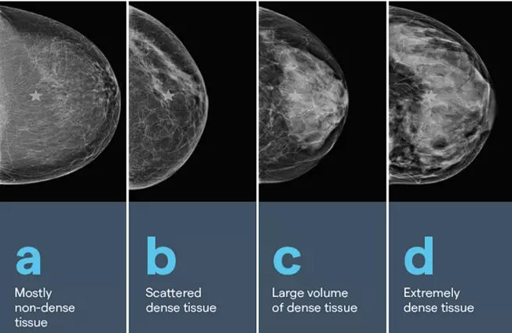

Technical Challenges:
Notes:
These images show us the different densities of breast tissues

Slide 6

RELATED WORKS
Overview of Previous Studies:
CNN-Based Approaches: Many studies have employed CNNs for breast cancer detection. For instance, Saad Awadh Alanazi's work utilized CNNs to analyze histopathological images, achieving an accuracy of 87%. However, CNNs tend to emphasize histopathological analysis, which is different from the probabilistic image generation and refinement approach of DDPM.
Deep Learning in Mammography: Other researchers have explored deep learning techniques, including CNNs, for mammography analysis. These studies aimed to reduce diagnostic errors and achieve accurate results. However, DDPM's unique denoising technique offers a different perspective on enhancing the visibility of cancer indicators.
Notes:
For a 15-second read, here are the concise points on previous studies in the context of breast cancer detection:
1. **CNN-Based Approaches:**
- Numerous studies, including that of Saad Awadh Alanazi, have utilized CNNs for breast cancer detection, achieving accuracies up to 87%. These approaches primarily focus on histopathological image analysis.
2. **Deep Learning in Mammography:**
- Various researchers have explored deep learning, especially CNNs, for mammography. Their goal was to reduce diagnostic errors and improve accuracy. However, DDPM's unique denoising approach offers a novel perspective in detecting cancer indicators.

Slide 7

RELATED WORKS
Limitations of Existing Methods:
Histopathological Emphasis: CNN-based methods often focus on histopathological analysis, which involves examining tissue samples under a microscope. DDPM, on the other hand, specializes in mammographic images, providing a newer approach in probabilistic image generation and refinement.
Variability in Performance: Some studies have reported variable performance with different ML techniques for breast cancer diagnosis. DDPM offers a novel way to improve accuracy and minimize false positives and negatives by progressively denoising mammographic images.
Data Availability and Privacy: Compiling large and diverse datasets for training ML models can be challenging due to data availability and privacy concerns. DDPM's reduced dependency on extensive labeled datasets addresses this limitation, making it more adaptable to real-world scenarios.
Notes:
For a 15-second summary on the limitations of existing methods in breast cancer detection:
1. **Histopathological Emphasis:**
- CNN-based methods mainly focus on histopathological analysis of tissue samples. In contrast, DDPM offers a novel approach in mammographic image analysis through probabilistic image generation and refinement.
2. **Variability in Performance:**
- Existing studies using various ML techniques show inconsistent performance in breast cancer diagnosis. DDPM introduces a method to enhance accuracy and reduce false positives/negatives by progressively denoising mammographic images.
3. **Data Availability and Privacy:**
- The challenge of collecting large, diverse datasets for ML due to data availability and privacy concerns is addressed by DDPM, which relies less on extensive labeled datasets, making it more practical in real-world applications.

Slide 8
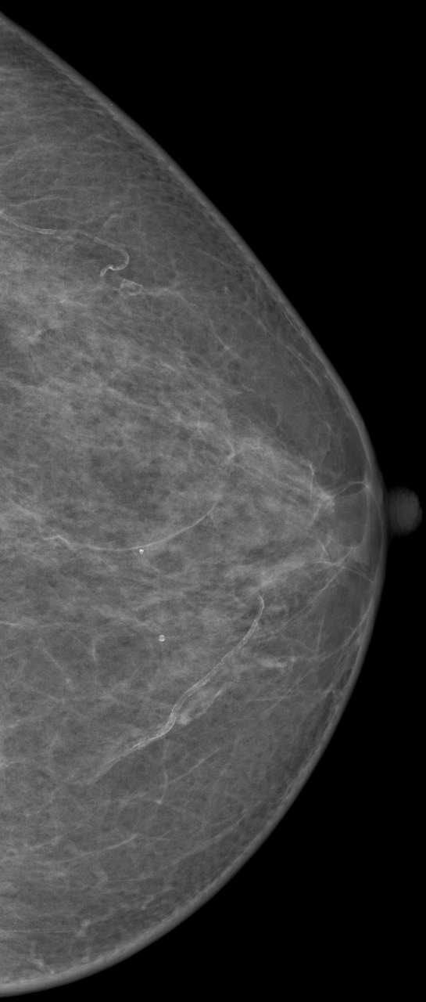

Approach
Adoption of Denoising Diffusion Probabilistic Model (DDPM):
The project focuses on employing DDPM, a novel deep learning technique, for detecting breast cancer. DDPM is recognized for its ability to process and analyze complex image data, especially in medical diagnostics.
Training on Non-Cancerous Images:
A critical aspect of the methodology is the training of the DDPM exclusively on non-cancerous mammogram images. Cancerous images were intentionally removed from the dataset, allowing the model to learn and recognize features characteristic of normal breast tissue.
Data Preprocessing and Reduction:
The initial dataset, consisting of mammograms, was extensively preprocessed. It involved resizing images to 256x256 pixels and converting them from DICOM to PNG format, thereby managing data size and maintaining image integrity.
A YOLOv5 object detector was utilized to identify and focus on regions of interest (ROIs) within the mammograms, enhancing the effectiveness of the model in detecting potential cancerous regions.
Notes:
RSNA Screening Mammography Breast Cancer Detection

Slide 9
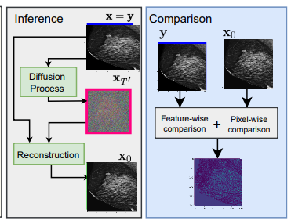

APPROACH
Model Architecture and Training:
The DDPM model incorporated a U-Net architecture, chosen for its proficiency in handling and analyzing image data.
The training process was conducted with a focus on adapting the model to accurately process and interpret the mammographic features associated with non-cancerous breast tissue.
Inference and Classification Process:
During inference, the model processes mammogram images (both cancerous and non-cancerous) by initially adding noise and then applying the DDPM to denoise these images.
The classification of images as potentially cancerous or non-cancerous is based on the analysis of differences between the denoised and original noisy images.
Optimization Techniques:
The model's performance was optimized using techniques such as sequential image refinement with pre-calculated noise variances and training optimization with the AdamW optimizer
Notes:
Model Architecture and Training:
The DDPM model utilizes a U-Net architecture, known for its effectiveness in handling and analyzing image data. This choice is pivotal in processing complex mammographic features.
The training was specifically geared towards enabling the model to accurately interpret features associated with non-cancerous breast tissue, which is essential for the model's diagnostic precision.
Inference and Classification Process:
In the inference phase, the DDPM processes mammogram images, both cancerous and non-cancerous. It starts by adding noise to these images, followed by denoising using the DDPM.
The crucial step in classification involves comparing the denoised images with their original noisy counterparts. The model classifies images as potentially cancerous or non-cancerous based on the differences observed in this comparison.This is done by calculating the pixel-wise difference between the two images, yielding a ”difference image” Idi
If S > ε: The image is classified as ’Cancerous’. • If S ≤ ε: The image is classified as ’Non- Cancerous
Optimization Techniques:
The model's performance was fine-tuned using several optimization techniques. This included sequential image refinement, where pre-calculated noise variances were applied to the images.
Additionally, the training process was optimized using the AdamW optimizer, ensuring that the model efficiently learns and adapts to the task of accurate breast cancer detection.

Slide 10
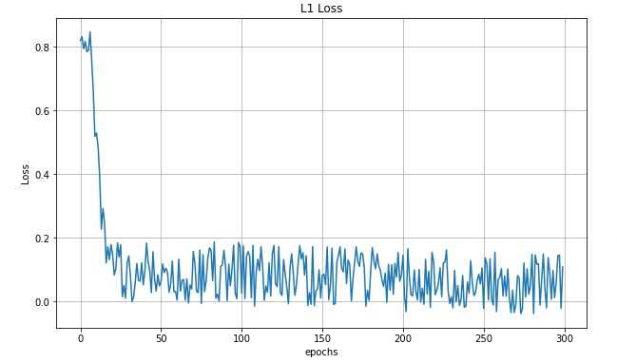

Results
Performance and Evaluation Metrics: The model achieved high accuracy, with metrics such as an mAP@50 of 0.995 and an mAP50-95 of 0.914 on the validation dataset. Demonstrated an overall classification accuracy of 91%, which is a significant improvement over traditional models.
Comparative Analysis: The DDPM model, through its unique training on non-cancerous images and subsequent application to unknown datasets, showed improved performance compared to conventional models in the field.
Acknowledged Limitations: The approach has limitations, including the inability to differentiate between specific types of breast cancer and the computational intensity of the model.

Slide 11
Broader Impact and Future Direction
Advancement in Breast Cancer Screening:
This study represents a significant leap in the field of medical imaging, particularly in enhancing early breast cancer detection where traditional methods may not be as effective.
Contribution to Medical AI Research:
The research enriches the area of AI in healthcare, showing how innovative AI models like DDPM can tackle specific challenges in medical diagnostics. This can inspire further advancements and explorations in the field.
Learning and Application Platform:
The methodology and technological insights from this study can serve as a valuable resource for researchers and practitioners. It provides a foundation for applying advanced machine learning methods in medical imaging and other relevant domains.

Slide 12
Broader Impact and Future Direction
Areas for Future Improvements-
Model Refinement for Cancer Type Classification:
Future developments could focus on enhancing the model's ability to classify specific types of breast cancer, providing more comprehensive diagnostic information.
Optimization for Wider Accessibility:
Reducing the computational intensity of the model is essential to make it more accessible and practical for diverse clinical environments.
Broadening Training Datasets:
Incorporating a larger, more varied dataset, including different cancer stages and types, would likely improve the model's accuracy and generalizability.
Integration with Patient-Specific Data:
Combining imaging analysis with individual patient data could lead to more accurate predictions and personalized screening processes.
Reducing Computational Demands:
A key area for improvement is to lower the computational demands of the model, making it more feasible for widespread clinical use.
Enhanced Cancer Type Identification:
Further refinements to enable the model to distinguish between different types of breast cancer would significantly increase its clinical value.

Slide 13
Broader Impact and Future Direction
Application in Solving Problems -
Adaptability to Other Medical Conditions:
The techniques and insights gained could be adapted to diagnose other medical conditions involving imaging, broadening the scope of AI applications in healthcare.
Aiding Medical Professionals:
This model could evolve into a crucial diagnostic tool, assisting healthcare professionals in more accurately identifying cancerous tissues.
Limitations -
Cancer Type Specificity:
The model’s current inability to identify specific types of breast cancer is a key limitation, as this information is critical for effective treatment planning.
Invasive vs. Non-Invasive Cancer Detection:
The inability to distinguish between invasive and non-invasive cancers is a notable limitation, impacting treatment decisions and patient outcomes.
Computational Demands:
The high computational requirements of the model could limit its practical use, especially in resource-constrained clinical settings.

Slide 14
Broader Impact and Future Direction
Computational Challenges:
Resource Intensity: The computational complexity and the need for substantial resources limit the model's accessibility, particularly in resource-limited settings.
Data Dependency: Effective performance relies on large, diverse datasets, which can be challenging to compile.
Areas for Future Improvement:
Enhancing Cancer Type and Stage Identification: Future work can focus on refining the model to identify specific types and stages of breast cancer.
Addressing Computational Efficiency: Research should continue to make the model more accessible and feasible in various healthcare settings.
Expanding Dataset Diversity: Efforts should be made to include more diverse datasets, enhancing the model's accuracy and applicability across different populations.
Conclusion: Paving the Way for Advanced Detection.
This project not only advances breast cancer screening but also sets the stage for transformative changes in medical diagnostics, encouraging further exploration and improvement in the field.

Slide 15
Thank you

